Slide 1

Amazon Delivery Project Documentation
Team Members: Yomna Elameer,Asmaa Khaled,Fatma Atef

Slide 2

Goal project:
The objective of this project is to enhance delivery speed by analyzing key factors influencing performance. The analysis aims to provide actionable insights that support faster, more efficient, and reliable deliveries.

Slide 3
Brief About The Dataset:
This dataset contains delivery orders from February, March, and April 2022. It includes details about the delivery agent, store and drop locations, and order timings. External factors such as weather and traffic conditions are also recorded. Finally, it tracks delivery time and product category, making it useful for analysis and service improvement:

Slide 4
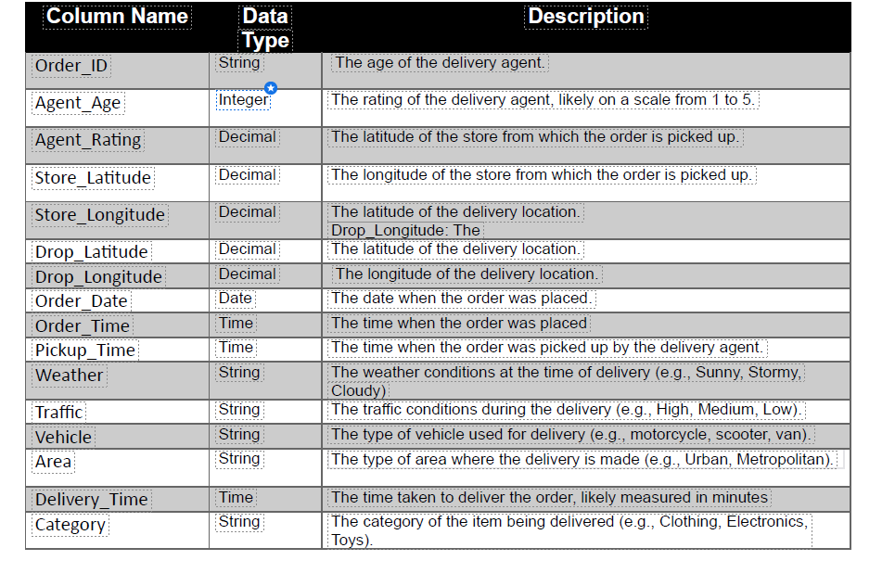
About Dataset
This Amazon Delivery Dataset provides a comprehensive view of the company's last-mile logistics operations. It includes data on over 43,632 deliveries across multiple cities, with detailed information on order details, delivery agents, weather and traffic conditions, and delivery performance metrics. The dataset enables researchers and analysts to uncover insights into factors influencing delivery efficiency, identify areas for optimization, and explore the impact of various variables on the overall customer experience.

Slide 5
Dataset Issues:
Order_ID:
· Description: Unique identifier for each order.
· Issues: No missing values, but values are non-numeric (strings).
· Handling: Kept as is since it is just an identifier.
· Impact: Used as a reference key, not for analysis.
Agent_Age:
Description: Age of the delivery agent.
Issues: Possible invalid values (e.g., <18 or >70).
Handling: Outliers filtered and replaced with median age.
Impact: Ensures fair analysis of age-related performance without skew.
Agent_Rating:
· Description: Customer rating of the delivery agent (1–5).
· Issues: 54 missing values.
· Handling : Missing ratings replaced with mean/median rating.
· Impact: Prevents bias in analyzing performance vs. ratings.
Store_Latitude & Store_Longitude:
· Description: Location of the store (pickup point).
· Issues: No nulls but long names.
· Handling: Renamed to Store_Lat, Store_Lon.
· Impact: Used for calculating delivery distance
Drop_Latitude & Drop_Longitude:
· Description: Location of the customer (drop point).
· Issues: No nulls, same naming issue.
· Handling: Renamed to Drop_Lat, Drop_Lon.
· Impact: Paired with store location to calculate delivery distanc

Slide 6
Dataset Issues:
Weather:
· Description: Weather condition during delivery.
· Issues: 91 missing values.
· Handling: Missing values replaced with “Unknown”. Categories grouped into Good_Weather, Bad_Weather, Extreme.
· Impact: Helped show delivery delays in stormy/sandstorm conditions.
Traffic:
· Description: Traffic level during delivery (Low, Medium, High, Jam).
· Issues: Inconsistent spelling issues (standardized).
· Handling: Cleaned and standardized categories.
· Impact: Strong correlation with delivery time (higher traffic → longer delivery).
Vehicle:
· Description: Vehicle type used (motorcycle, scooter, etc.).
· Issues: No nulls.
· Handling: Standardized text formatting.
· Impact: Compared delivery times between vehicles.
Area:
· Description: Type of delivery area (Urban, Semi-Urban, Metropolitan).
· Issues: Typo in “Metropolitian” → corrected to “Metropolitan”.
· Handling: Standardized category names.
· Impact: Used to compare delivery speed in different regions.
Delivery_Time:
· Description: Actual delivery duration in minutes.
· Issues: Possible extreme outliers (too small or too high).
· Handling: Outliers capped based on IQR method.
· Impact: Provided reliable analysis of delivery efficiency.
Category:
· Description: Type of product ordered (Clothing, Electronics, etc.).
· Issues: No nulls. Some categories very small in count.
· Handling: Kept all, but grouped very rare categories into “Other”.
· Impact: Helped analyze if product type affects delivery time.

Slide 7
Data Cleaning and Preprocessing :
1. Column Renaming:
Problem:
· The column Agent_Rating was not fully descriptive
Solution:
· Renamed to Order_Rating for clarity
Impact:
· Clearer understanding that rating refers to the order

Slide 8
Handling Missing Values:
Order_Rating:
Problem:
· Missing ratings
Solution:
· Filled with the median rating
Impact:
· Prevented bias and preserved data distribution
Weather:
Problem: Missing weather conditions.
Solution: Filled with the mode value (“Fog”).
Impact: Maintained realistic category distribution.
Traffic:
Problem: Some values stored as the string 'NaN '.
Solution: Replaced with actual NaN.
Impact: Ensured accurate handling of missing values.
Order_Time
Problem: Invalid placeholders such as 'NaN' text.
Solution: Converted them to proper NaN.
Impact: Cleaned time column for later datetime conversion.

Slide 9
Outlier Detection & Treatment:
Agent_Age
Checked distribution → detected possible outliers (e.g., very young or very old ages).
Order_Rating
Checked distribution → ensured values within valid range (1–5).
Delivery_Time
Distribution examined for extreme values.
Distance_km
Used boxplot + IQR method.
Filtered rows outside [lower_bound, upper_bound].
Impact: Outliers removed → improved accuracy of averages and predictive modeling.

Slide 10
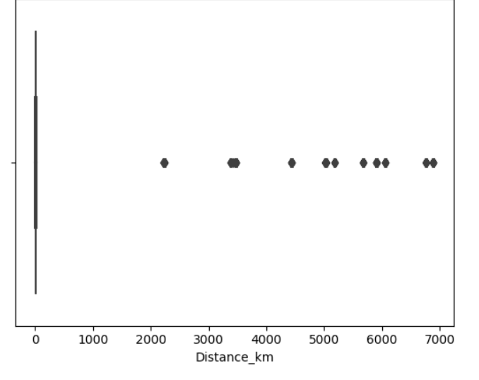
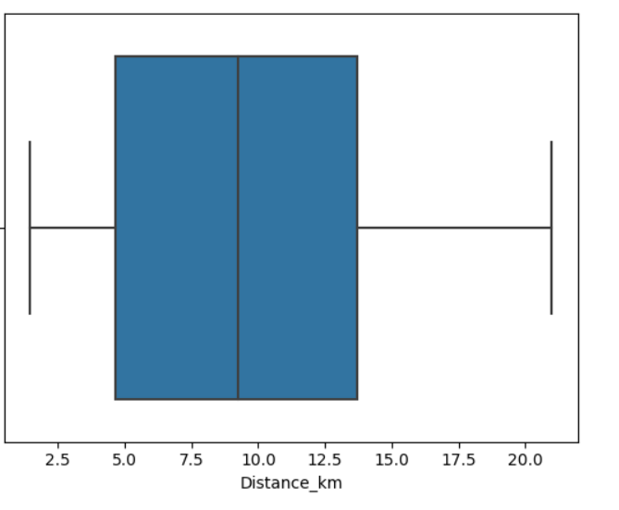
Outlier Detection & Treatment:
Check outliers in distance
After handle outlier

Slide 11

. Feature Engineering:
Weather_Category:
Created a new column grouping weather into categories:
Good_Weather: Sunny
Bad_Weather: Cloudy, Windy, Fog
Extra_Bad_Weather: Stormy, Sandstorms
Impact: Simplified weather impact analysis on delivery.
Order_DateTime:
Combined Order_Date and Order_Time into a single datetime column.
Impact: Enabled time-based calculations (waiting time, delays, peak hours).
Order_Time_Category:
Created a new column grouping order_time into categories:(Morning, Afternoon, Evening, Night)
Area_Category : Created a new column grouping area into
Categories:(Urban, Metropolitan,Other)
Distance_km: Calculated using the Haversine formula based on pickup and drop-off GPS coordinates.
Speed_kmph: Computed using the formula:
Speed(km/h)=Distance_kmDelivery_Time(minutes)/60Speed (km/h) = \frac{Distance\_km}{Delivery\_Time (minutes) / 60}Speed(km/h)=Delivery_Time(minutes)/60Distance_km​
Final dataset now contains two additional columns:
Distance_km
Speed_kmph

Slide 12
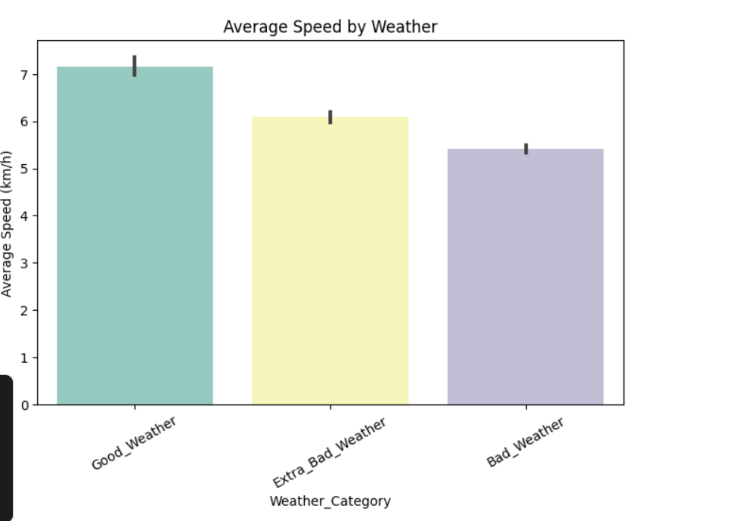
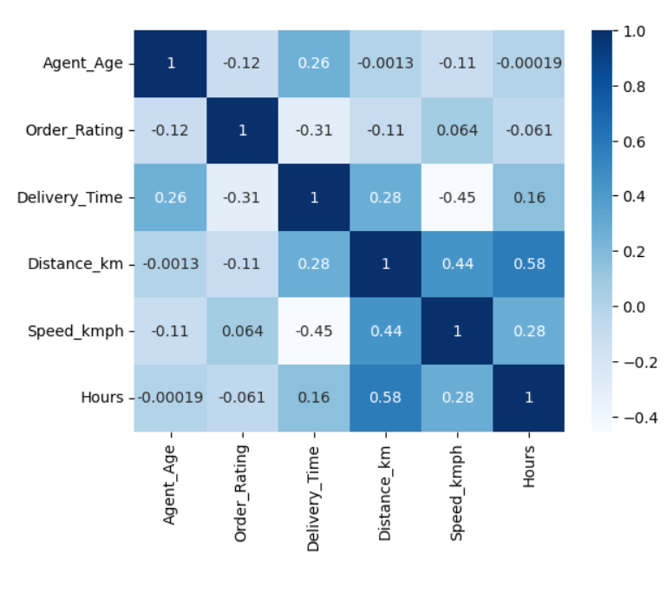
Visualization:
Correlation between numerical column
Average Speed by Weather

Slide 13
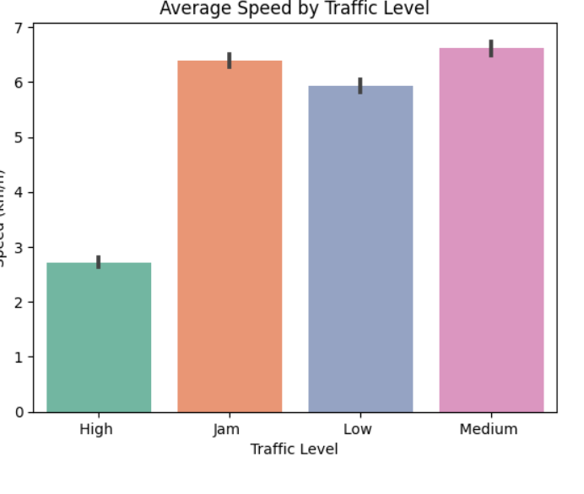
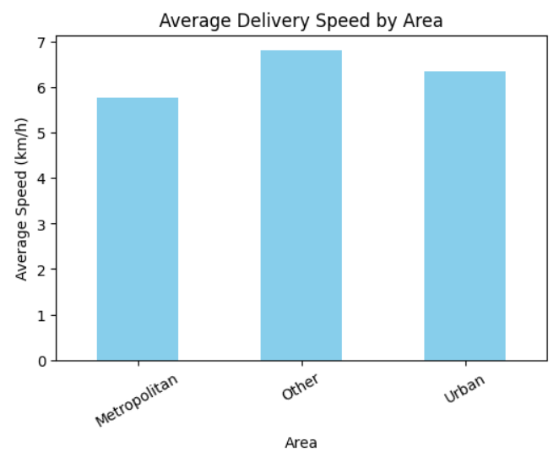
Business Questions they might ask :
Analysis Optimization On Delivery speed:
How does traffic impact delivery speed?
Do area categories affect delivery speed?

Slide 14
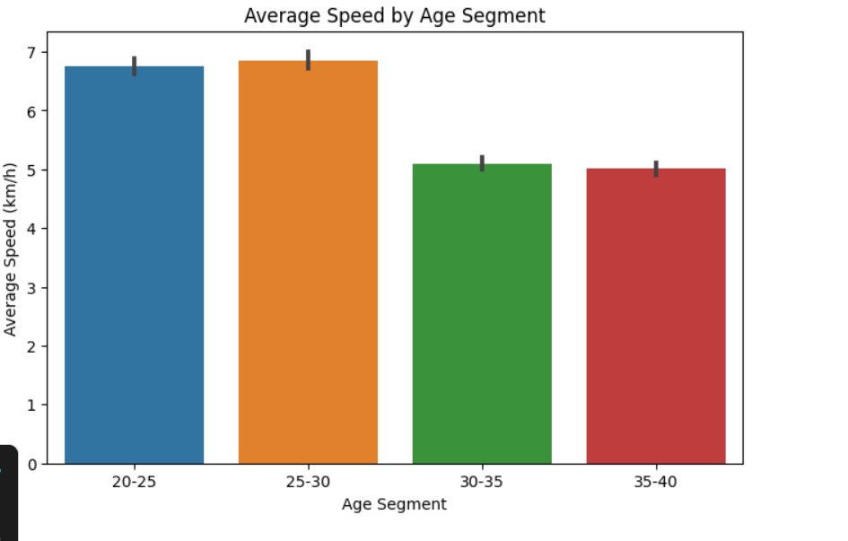
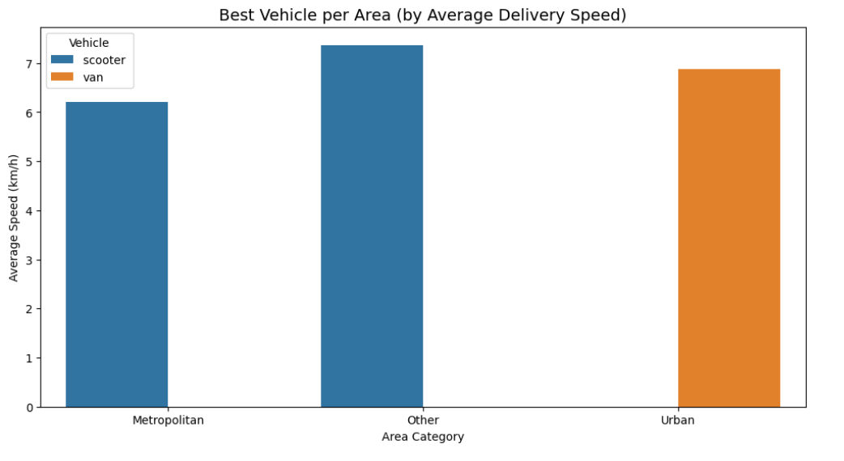
Which type of vehicle achieves the highest average delivery speed in each area category?
Do age segments affect delivery speed?

Slide 15
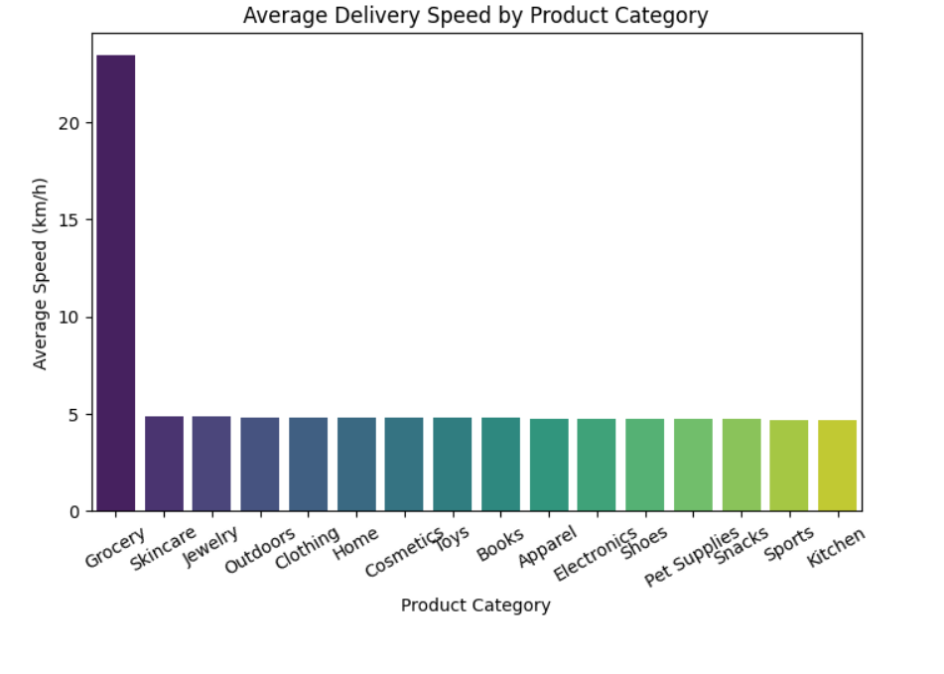
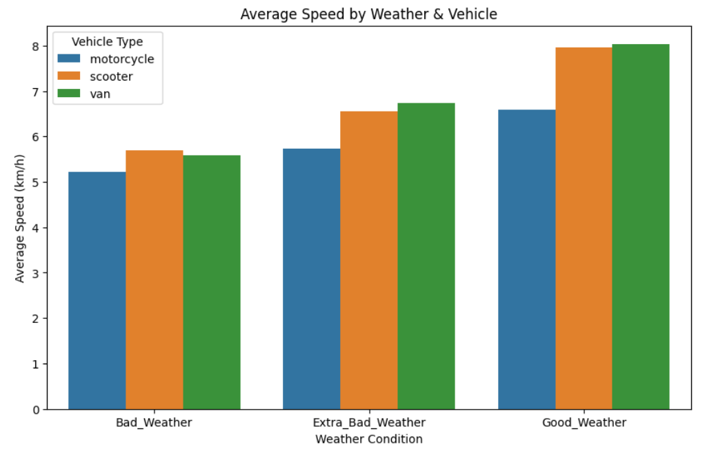
Which categories of products are delivered faster?
How do weather conditions and vehicle types together impact delivery speed?

Slide 16
Insights:
Traffic Impact on Delivery Speed
Higher traffic congestion significantly reduces delivery speed.
Low and medium traffic conditions result in faster deliveries.
Area Categories Effect
"Other" areas have the highest average delivery speed.
Metropolitan areas show moderate performance.
Urban areas are the slowest, likely due to dense population and road restrictions.
Product Categories
Groceries have the fastest delivery speeds (20+ km/h), possibly due to priority handling.
Cosmetics and Toys also perform relatively well.
Books and Apparel have the lowest delivery speeds.
Vehicle Types by Area
.Scooters perform best in Metropolitan and Other areas.
. Vans are more effective in Urban areas (despite overall slower speed

Slide 17
Weather & Vehicle Impact:
  Good weather boosts delivery speed across all vehicle types.
  Motorcycles consistently achieve the highest speeds, followed by scooters, then vans.
Age Segments:
  Younger delivery personnel (20–25, 25–30) achieve higher speeds.
  Older segments (30–35, 35–40) tend to be slower, suggesting age impacts efficiency.

Slide 18
Recommendations:
Traffic-Aware Route Optimization:
nvest in AI-driven dynamic routing to avoid high-traffic zones.
Use real-time traffic monitoring to adjust delivery routes.
Area-Specific Strategies:
For Urban areas, optimize van routes and consider micro-hubs to reduce congestion delays.
For Metropolitan & Other areas, focus on expanding scooter fleets for faster deliveries.
Product Delivery Prioritization:
Maintain strong focus on groceries as they show highest delivery efficiency.
Introduce speed-enhancement processes for slower categories like books and apparel (e.g., batching, pre-sorting).
Weather-Adaptive Policies:
  On bad weather days, prioritize motorcycles with trained riders for efficiency.
  Implement safety-first delivery SLAs (slightly longer timelines during storms to balance speed & safety).
Workforce Optimization:
  Recruit and train more delivery riders in the 20–30 age group for higher performance.
  Provide performance-based incentives to motivate older segments to match efficiency.
Fleet & Operations:
  Expand scooter and motorcycle fleet where possible to maximize speed.
  Deploy vans strategically in urban congested zones where small vehicles can’t carry volume.

Slide 19
Conclusion:
.
Overall Strategy:
Use data-driven route planning (traffic + area).
Build area & product-specific delivery policies.
Optimize fleet allocation (motorcycles/scooters for speed, vans for capacity).
Focus on younger workforce segments while supporting older riders with incentives.
Conclusion:
Delivery speed is strongly affected by traffic, area type, product category, vehicle type, and driver age. By improving route planning and using the right vehicles for each area, companies can increase efficiency and achieve faster deliveries.

